Slide 1
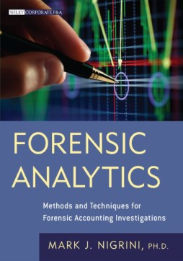
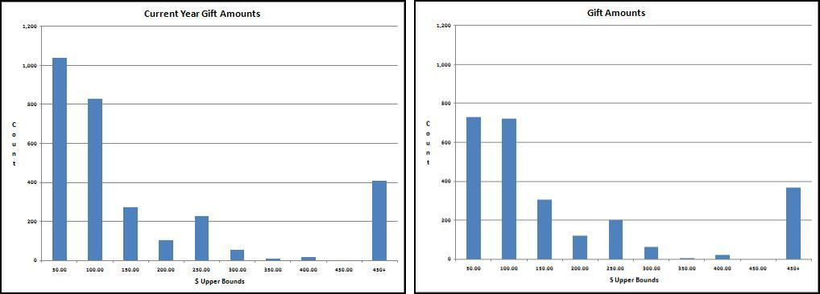
Chapter 9
Compare data from two time periods
Descriptive statistics
My Law
Minitab software
Prepared by:
Mark J. Nigrini
Copyright © 2012 by Mark J. Nigrini. All rights reserved.
Notes:
Pages 173 to 190.
Chapter shows some statistical methods to assess whether there is internal consistency of data from period to period.

Slide 2
introduction
Comparisons to detect changes
Bolton and Hand, actual data compared to a set of expected values
Golden+, discuss comparison of details
We proactively set out to evaluate the risk of fraud or errors
Parallel scan compares two sets of data
Notes:
Pages 173 to 175.
General discussion on comparing data from two time periods.

Slide 3
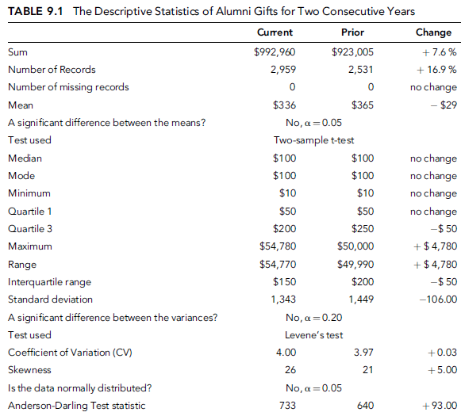
gift data
Notes:
Page 176.
Table 9.1.
The case study involves alumni gifts to a college. Each gift amount was a contribution from a past student. The contributions are for two consecutive years.
The first set of descriptive statistics gives us an overview of the data. The overview consists of the sum, the number of records, and the number of missing records. In a forensic analytic project the sum should agree with, or should be reconcilable with the trial balance to ensure that all the account details are included in the analysis.
The second set of descriptive statistics relates to measures of central tendency. The mean, median, and the mode are often used in the financial press and are understood by most forensic investigators. A large change in either of these values should be investigated.
The third set of descriptive statistics measures the variability or the spread of the numbers. This set includes the minimum and maximum, the interquartile range, and the range (the maximum minus the minimum amount). This set of values includes the minimum amount which might yield investigative insights if the number was negative in a data set that should not contain negative numbers (e.g., wages, inventory counts, coupon or rebate amounts, or odometer readings). Large changes in the variability values could be a red flag for fraud or error.
The final set of values relates to the shape of the distribution of the data.

Slide 4
histograms
Notes:
Pages 178 to 182.
Figure 9.1.
The histograms of the gift amounts are shown in Figure 9.1. Using ten intervals and a width of $50 for each interval gives a final tenth interval for amounts of $450 and higher. The y-axis (the count) for the current and prior year should be comparably calibrated (from 0 to 1,200 in this case) so that the histograms can be compared visually. For the gift data the histograms are similar except for the first two intervals (0 to $50, and $50.01 to $100) which have noticeably higher counts in the current period.

Slide 5
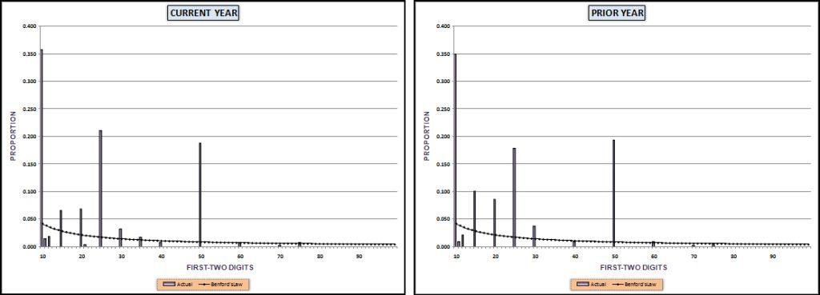
first-two digit tests
Notes:
Pages 178 to 182.
Figure 9.2.
The gift amounts were not expected to follow Benford’s Law because gifts are influenced by human thought since the donor thinks up an amount to give. This number invention process usually sees a gravitation towards round numbers that are psychological thresholds. Also, donor recognition levels also influence the gift amounts. The first-order results for both years are shown in Figure 9.2.
The MAD for the gift data is 0.0015 and this gives us a comfortable close conformity conclusion.

Slide 6
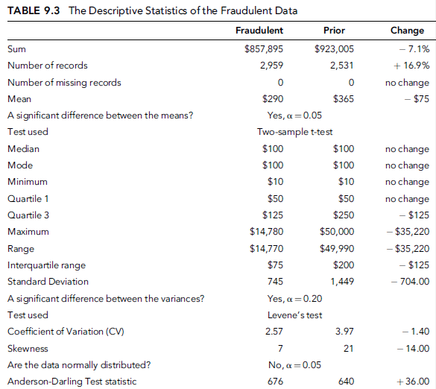
fraudulent data
Notes:
Pages 182 to 189.
Table 9.3.
The fraud is based on the recognition that donors receive from the college based on the amount of the gift. It is quite normal for donors to give an amount that would just qualify for some recognition level. The fraud in this case was that the accountant diverted funds for his personal use, constrained by the fact that the donor would complain if they were given an inferior recognition level at college events. With the recognition level constraint only about one-half of the gifts had any dollars that could be “skimmed off the top.” An example of the fraud is recording $7,000 as $5,000 to siphon off $2,000 leaving the donor still a member of the “Platinum Society,” which recognizes gifts from $5,000 to $9,999. There was no skimming (theft) of amounts under $150.

Slide 7
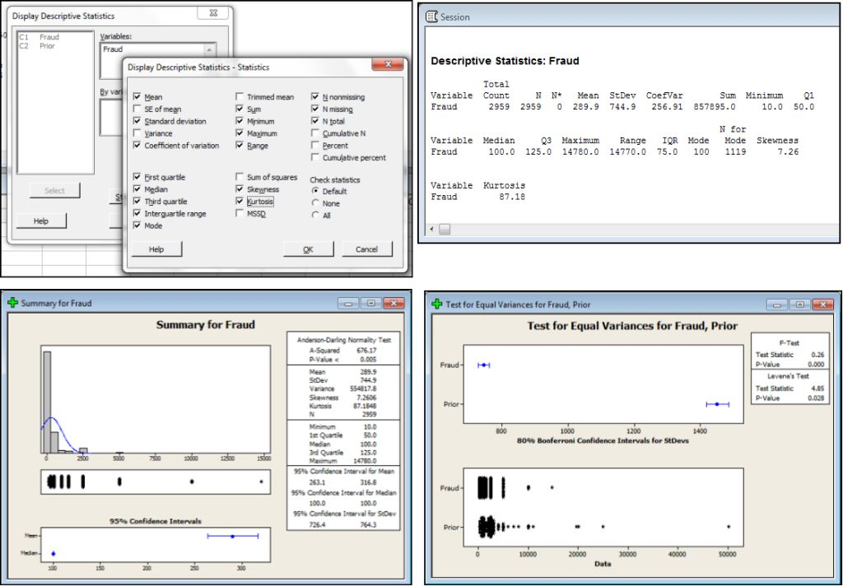
minitab
Notes:
Page 186.
Figure 9.5.
Minitab does an excellent job with descriptive statistics. The Minitab steps to calculate the descriptive statistics are Stat→Basic Statistics→Display Descriptive Statistics. The fraud data results are shown in Figure 9.5.
The Anderson-Darling test is run in Minitab using Stat→Basic Statistics→Graphical Summary and the comprehensive results are shown in the third panel in Figure 9.5. Levene's test for equal variances is run using Stat→Basic Statistics→2 Variances. Minitab is user friendly, and easy to use and to understand. Data can be imported into Minitab using the familiar Copy and Paste steps. Extensive help is available in Minitab to explain the results and the formulas used in the program.

Slide 8
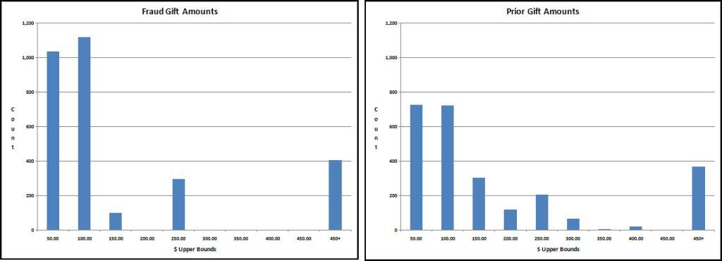
histograms
Notes:
Pages 185 to 189.
Figure 9.6.
The results show that the counts for the lower values for the fraudulent data are higher than the counts for the lower values in the original data.
The histogram gives us no indication that the sum has decreased by 14 percent because histograms measure counts and not sums. Most of the siphoning off by dollar value took place in the bin for $450+, and while the dollar amounts were reduced (in one case by $40,000 and in another case by $17,895), the counts (which is what a histogram is all about) were not noticeably affected. This highlights the fact that each descriptive statistic or graph only looks at one characteristic of the data.

Slide 9
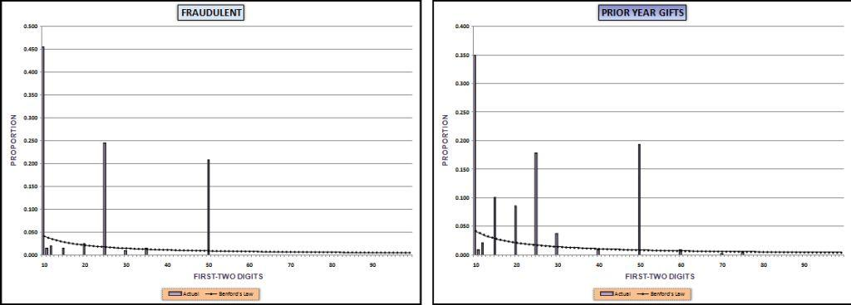
first-two digit tests
Notes:
Pages 188 to 189.
Figure 9.7.
The first-order tests in Figure 9.7 shows a surprising result. The focus is on a comparison of the first-order results between the current and the prior year, with the Benford proportions included only as reference points. The digit patterns of the fraudulent data and the prior data are not wildly different.

Slide 10
summary
Tests to compare the detail in current and prior period data
Descriptive statistics looked at an overview, central tendency, variability, and shape
Histogram also looked at shape of distribution
Digits test used My Law concept
Fraudulent data showed some differences but not wildly different to prior period data
Can be used for continuous monitoring
Notes:
Pages 189 and 190, and a review of the main points.

